Slide 1
Contracting Presentation
Nathan Bradley
Strategic Acquistion Center-Frederick
October 16, 2019

Slide 2
AGENDA
Steps in the Process
Requirements Center for Excellence (FORCE) Submissions
Phase 1- Requirement Definition
Phase 2- Market Research
Phase 3 – Solicitation
Phase 4 – Evaluation
Phase 5 – Award/Post Award
Timeline
Contracting POC

Slide 3
STEPS in the PROCESS
Retrieve Innovation Requests
Enter Request into FORCE (See next Slide for details)
We will review the submitted packages and documentation, and will reach out to the Innovation Specialists with any questions/comments/concerns.
This will be an iterative process where we will fine-tune the requirement details, and work towards awarding a contract.
3. Phases of Contracting
Requirement Definition
Market Research
Solicitation
Evaluation
Award
COMMUNICATION IS THE KEY TO SUCCESS!

Slide 4
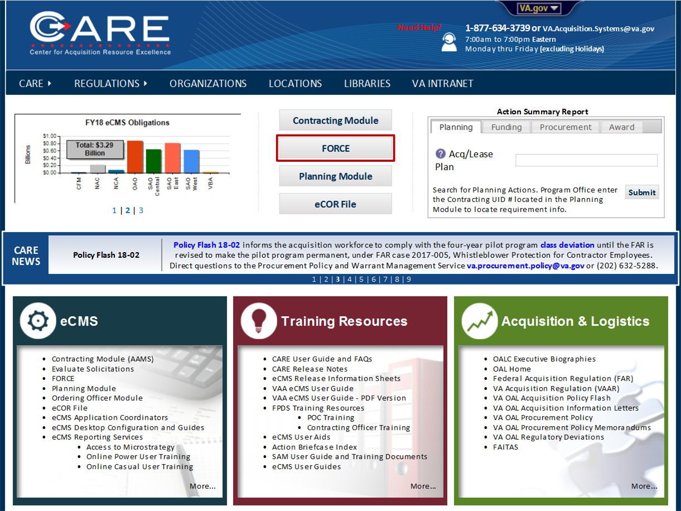
FORCE Submissions
Access the CARE Portal (https://vaww.ecms.va.gov/care/)
Select FORCE
If you need a FORCE account- Click Create Account
If you do not need a new Account, start entering the data.
ASSISTANCE:
For questions or further assistance using FORCE, contact your eCMS Application Coordinator or VA Acquisition Systems Help Desk at va.acquisition.systems@va.gov or (877) 634-3739.
For information on subjects not included in this guide, please access the Center for Acquisition Resource Excellence (CARE) for additional User guides, and Training Resources.

Slide 5
PHASE 1- Requirement Definition
Requirement should be written to describe what the agency needs, not tailored to a specific brand/company
If requirement is for a specific brand name or only one contractor has been identified who can perform the service, then a Justification will be required.
Requirement should include necessary quantities, delivery dates, and any special considerations
Innovation Specialists need to determine which evaluation factors are important for the requirement
Lowest Price Technically Acceptable – use this when price is the most important factor, and the requirement is easily defined
Comparative Analysis/Trade-offs – use this approach when other factors are more important than price (past performance, technical capability, etc.)
Upon receiving the package, the Contract Specialist will review the documentation and reach out to the Innovation Specialist with an introduction and a list of required additional information/documentation needed to complete the package
NOTE:
Actionable Package = defined requirement, meaning all supporting documentation are complete and accurate, and funds provided in an amount no less than IGCE

Slide 6
PHASE 1- Requirement Definition (continued)
Required Documents for an actionable package:
Non-personal services MFR (use when the requirement is for services)
Inherently Governmental Functions MFR
6500 – must be signed by local ISO
COR Nomination Letter and COR certificate
Use when requirement is for services or for when there will be multiple deliveries that require Government coordination
Independent Government Cost Estimate (IGCE)
The Government’s estimate as to how much this requirement should cost. Can be based on posted prices, informal quotes, historical pricing, etc.
Statement of Work/Performance Work Statement/Product Description
Shall be written to clearly and objectively describe the agency’s needs, and not tailored for a specific brand name or one single contractor unless a justification is provided.
Market Research document, filled out
Template includes highlighted sections – please address all, and if unsure as to what to put, please leave a comment
Funding (or confirmation that funds are available from VHA Innovators Network)

Slide 7
PHASE 2 – Market research
Market Research typically takes 5-7 days, depending on complexity
Innovation Specialists will perform initial Market Research to determine:
Is this commercially available?
Who sells this item/service?
What types of competing products/services are available?
Once the requirement is fully-defined, the Contract Specialist will perform additional Market Research to confirm and determine:
Is this commercially available?
Who sells this item/service?
Are any Veteran-owned Small Business capable of performing the requirement?
Are there any existing Government contract vehicles available to streamline the purchase?
The best contract type/method to obtain the required items/services

Slide 8
Phase 3- Solicitation
Solicitation (typically 10-20 days, depending on complexity)
Once Market Research has been performed and the Contract Specialist knows the best set-aside/acquisition strategy to apply, the solicitation will be created and posted/distributed.
Depending on the dollar amount and the results of the market research, some requirements may be posted to FBO.gov (for at least 15 days), others may be distributed via email, and others may be posted to other sites/portals to reach their intended vendor audience.
During this time the Innovation Specialists may need to assist in a Q and A period.

Slide 9
Phase 4- Evaluation
Evaluation (typically 5-10 days, depending on complexity and number of offers)
Contract Specialist will review all offers received, and will utilize the Innovation Specialist to perform some aspects of the evaluations.
Evaluations must be done in accordance with the language included in the solicitation
Contract Specialist will provide guidance and templates to assist in this process.

Slide 10
Phase 5 – award/post award
Award (documentation typically takes 4-6 days)
Once the offers are received and evaluated, the Contracting Officer will make a decision regarding which offer represents the Best Value to the Government, and will make an award
Upon award, the Contract Specialist will prepare and distribute the “COR Delegation Form”, which will delegate specific responsibilities to the COR for that specific contract.
Post-Award
After contract is awarded, you may have a kick-off meeting, or you may move forward with obtaining the contracted items/services
Pay close attention to the language in the COR Delegation Form – if any issues arise during contract performance, please reach out to Contracting early and often

Slide 11
Timeline
Rough estimate of typical timeline for acquisitions estimated to be at or below $250K (time begins once package has been determined actionable):
Market Research: 5-7 days
Solicitation: 10-20 days
Evaluation: 5-10 days
Award: 4-6 days
Total estimated timeline: 24-43 days once package is determined to be actionable, depending on complexity.
Situations that may cause extended timelines:
Market Research determines that no veteran-owned small businesses can provide required products/services
Typically adds 5-10 days
Questions during solicitation phase
Depending on questions asked, the Government may need to extend the date and time that offers are due
Typically adds 5-10 days
No acceptable offers are received from the solicitation
Solicitation will need to be reposted, which will typically add an additional 10-20 days
Protest
If a vendor protests, it could delay the procurement by up to 100 days.

Slide 12
Tips for success
If supplies:
We are confident no other vendors can provide supplies:
Sole Source Justification
We think no one else can provide supplies:
Brand name or equal salient characteristics
We think anyone can do it
Salient Characteristics
If Services
Services are only provided by one vendor:
Sole Source justification
Services are provided by several vendors:
Clearly describe the desired outcome, and clearly describe the tasks that will be performed.

Slide 13
Case study – cards for connection
IGCE: $50,000.00, Final award: $44,937.47 (to an SDVOSB)
Requirement: 13,000 Custom-art 52-card playing card decks with waterproof case and mini sharpie marker
Original request: “Should be high quality card stock with a linen finish, print in color. Cases need to be waterproof and durable, individually hold and protect each card deck. Mini permanent markers shipped with cards and case.”
Solicitation:
Card Stock: 310 gsm Casino
Card Finish: Linen
Card Size: Poker (2.5” x 3.5”)
Cards Per Deck: (54) Standard 52-card deck plus 2 Jokers
Custom Artwork: Draft of Custom artwork is attached. Final version will be provided after award with minimal changes.
Cello Wrapped
Marker: Permanent, Fine Point, standard colors accepted (Black, Red, Blue, Green)

Slide 14
Case study – inform-a-vet
IGCE: $87,240.00, Final award: $83,916.00
Requirement: SMS Messaging to patients and family members of surgical services.
Original Request: “Unlimited messaging. Includes consultation, setup, online training, 24/7 support.”
Solicitation:
Software-as-a-service solution that allows log-in to one account on multiple devices – to include access from Desktop computers as well as iPads
Product must be available by access to application website, and no mobile application shall be required to send or receive messages; no portal shall be required to receive messages; no charges shall be applies to recipients beyond their local carrier data/text charges, if applicable.
Product must be able to send and receive text messages from any logged in device to/from one or multiple recipients
Product must allow for templated messages to be easily created and selected from the web services
Product must be accessible from multiple areas or departments within each Medical Center without additional charges/fees
Service must be provided for unlimited messages
System must scrub/wipe/purge phone numbers after 7 days
Vendor must provide consultation, setup, online training, and 24/7 on-line and phone support

Slide 15
Contracting POC
Contacting your Contract Specialist
Once your package is received, the assigned Contract Specialist will reach out to the Innovation Specialist with an introduction and request for any additional information/documentation
Please coordinate with your Contract Specialist regarding any concerns or questions you have with your contract/project
How can I be reached?
Please feel free to contact me with any questions or concerns:
Phone: 202-412-6433
E-mail: Nathan.bradley2@va.gov

